Slide 1
Step Into Java:
Alter Your Pix
Mr. Neat
Java

Slide 2
Alter Our Pix
We have some partially written code designed
to manipulate pictures
We will first act as a Client with this code, then
add some new methods

Slide 3
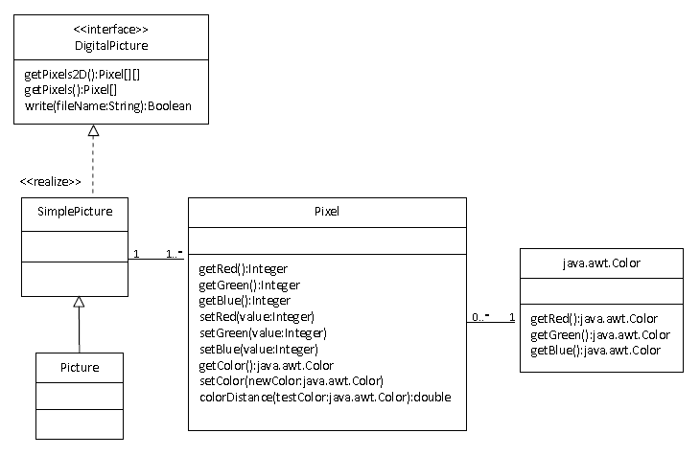
Picture Code Overview

Slide 4
Picture Code Overview
Let’s remove the color blue from
a Picture…

Slide 5
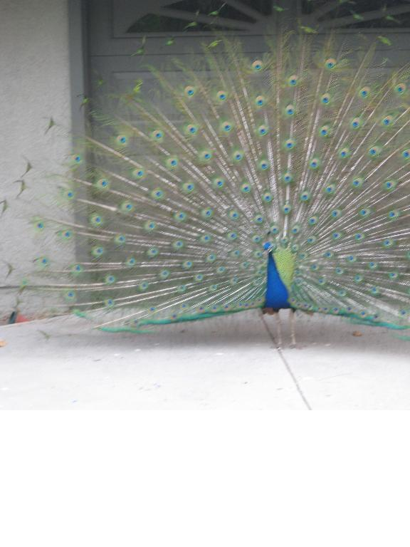
Picture Code Overview
Color joe = new Color(26, 89, 255)

Slide 6
Picture Code Overview
Color joe = new Color(26, 89, 255)
change to:
Color joe = new Color(26, 89, 0)

Slide 7
Picture Code Overview
Pseudo Code:
Get 2D Array of Pixels
Visit each Pixel
Set the blue Color value of
each Pixel to zero

Slide 8
Picture Code Overview
Client Side (PictureTester.java):
public static void testZeroBlue()
{
Picture beach = new Picture(“peacock2.jpg");
beach.explore();
beach.zeroBlue();
beach.explore();
}

Slide 9
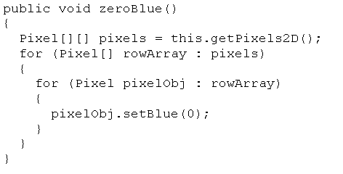
Picture Code Overview
class Side (Picture.java):

Slide 10

Lab – Altering Pix
Test your code!

Slide 11
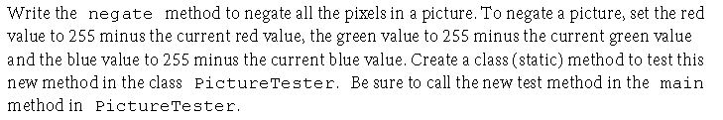
Lab – Altering Pix
Test your code!

Slide 12
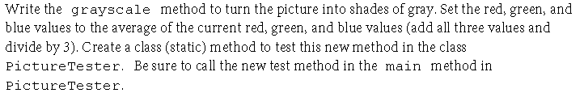
Lab – Altering Pix
Test your code!

